Slide 1
Citi Para Swimming World Series France
Technical Meeting
Thursday, 25th May 2023 – 18:00

Slide 2
Welcome
Citi Para Swimming World Series France 2023
This is the 7th Round of the World Series here in France
Before us has been:
Australia
Italy
Great Britain
USA
Berlin
Singapore

Slide 3
Introductions
LOC Meet Director
Adrien BALDUZZI
World Para Swimming Staff
Nicole Burns
Chief Classifier
Margaretha Maria Francisca Henrica
LOC Co-Meet Director/main contact
Sami EL GUEDDARI
World Para Swimming Technical Delegate
Tony WARD

Slide 4
Competition Officials
Classifier team of:
6 PI Classifiers
4 VI Classifiers
Technical Officials team of:
52 National Technical Officials
Tolerances of AOE system

Slide 5
Competition Rules and Regulations
The competition is run under WPS Rules and Regulations 2018
New Rules come into operation in June
ttps://www.paralympic.org/swimming/rules

Slide 6
Citi Para Swimming World Series Rankings
World Series Points will be calculated using the WPS Points system, further details can be found at: https://www.paralympic.org/swimming/world-series-2023
Rankings: after the competition once the result are uploaded, the World Series Performance Scores will be calculated (2 best scores used) and go into the World Series rankings. This can be found at: https://www.paralympic.org/swimming/rankings
Points will only be calculated for swimmers competing in events recognised under rule 10.4.1 of the WPS Rules and Regulations 2018. If athletes swim in more than one World Series Competition, their two best World Series Performance Scores will be added up
After each World Series event, the updated World Series rankings will be updated on the WPS website https://www.paralympic.org/swimming/rankings

Slide 7
Venue Orientation
Your accreditation will only permit access to areas required for the competition and is issued on a personal basis and must NOT be swapped around between people
TD/WPS
LOC
SID
Press
Spectators
VIP
Warm Up
Competition pool
VIP
Call Room
Ref
Athletes
VC
Bio Filming
Athlete Preparation Area
Medic

Slide 8
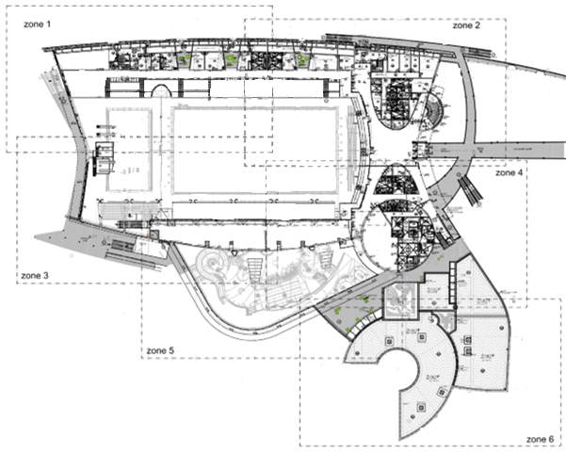
AQUAPOLIS – GENERAL PLAN
DROP IN & OFF NPC’s
Volunteers
ACCESS
NPC’s & JURY
Press
Stands for spectator and NPC
Warm up
pool
Compétition pool
Tribune VIP
Welcome desk and accreditation
Main entrance
Chambre d’Appel 1
PARKING
Chambre d’Appel 2
Protocol area
Stands NPC’s
Restauration NPC’s
Restauration
Accrédités
Medical
NPC’s AREA
Restauration
Accrédited
Anti-Doping
Area Pres & Médias
Area WPS
Snack area
Office VIP restauration

Slide 9
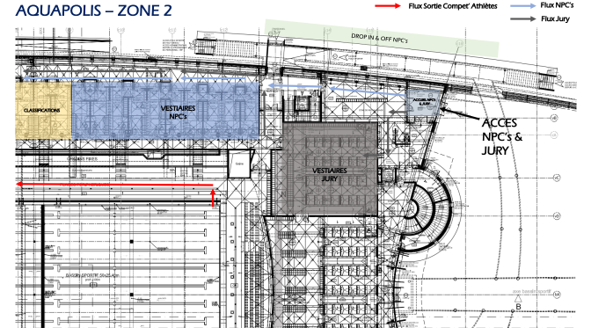
AQUAPOLIS – GENERAL PLAN

Slide 10
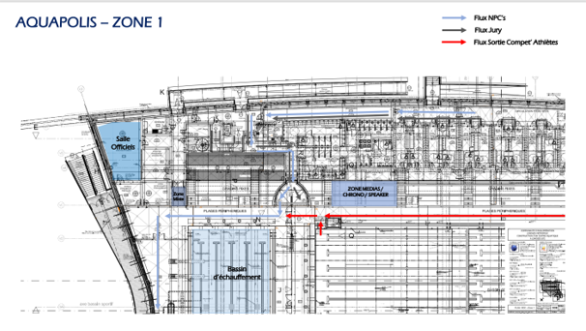
AQUAPOLIS – GENERAL PLAN

Slide 11
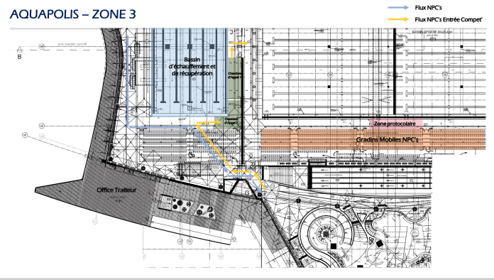
AQUAPOLIS – GENERAL PLAN

Slide 12
Warm Up Procedure During Competition
Competition pool: Morning : 07:00 – 08:45 Afternoon: 15:00 – 16:45
Training Competition pool: The 25m pool (5 lanes) will be open to the entire competition from the beginning of the warm-up and up to 30 minutes at the end of the sessions.
Accompanied by a coach and support staff
No changing on competition poolside
No fins, cords, or paddles allowed during the warm up (both pools)
Only athletes competing in the session during the warm up

Slide 13
Warm Up Procedure During Competition
WARM-UP:
50m pool Lane 0 - Reserved for S1/S3 category swimmers Lane 1 - Reserved for swimmers in categories S4/S5
Lane 2 - Reserved for swimmers in categories S11/S12 Lane 3 - Reserved for pace work Lane 4 - Reserved for swimmers in categories S4 and above Lane 5 - Reserved for swimmers in categories S6 and above Lane 6 - Reserved for swimmers in categories S6 and above Lane 7 - Reserved for swimmers in categories S6 and above Lane 8 - Last 30 minutes before evacuation reserved for start and turn work - One Way Lane 9 - Last 30 minutes before evacuation reserved for diving work only - One Way 25m pool: A recovery pool will be available to swimmers during the competition. It will be open on the same time slots as the competition pool. Only swimmers engaged in the competition will be able to access the pool.

Slide 14
Competition Preparation
Medical Taping – Open wound, pressure sores, stoma, sensitive skin. Must be approved before the start of each session.
The Referee will be available, at the referees table 45minute before the start of the session, until the end of the warm up, to approve legitimate taping.
Tapping Devices, Starting Devices and modified costumes can be approved at the end on this Meeting

Slide 15
Competition Format
HEAT
Heats will be seeded by entry times only
Heats will be conducted with the Citi Para Swimming World Series and Fédération Française Handisport Para-Swimming Meet heats combined within the Heats session. The result at the end of the heats will be on two different documents, one for the world series and one for the national event.
The lane allocation will be conducted in accordance with W.P.S rules and regulation 10.9

Slide 16
Competition Format
FINALS
Citi Para Swimming World Series Finals
The highest points scoring competitors in each event as determined by World Para Swimming Point Scores 2023 – Long Course Events will be eligible for the Finals.
Lane allocation in all Finals will be seeded by qualification time for each final in accordance with WPS rule 10.9.1.3.1.
Finals competition format will be as follows:
World Series Youth Final (2003 and above )
For the event with more than 20 athletes entered including 8 athletes borned in 2003 and above
This final have the priorities over the B final
World Series B Final
For the event with more than 30 athletes entered if a youth final is vaiable
For the event with more than 20 athletes entered if no youth final is vaiabale
World Series A final
This final have the priorities over the youth final and the B final
World Series Finals will be swam after the National Finals are concluded for that event.
If necessary, a swim-off may be used to determine swimmers for a final, where points scores are equal, unless the swimmers are the same class then the fastest swimmer shall progress.
There will be 2 reserve swimmers for Finals. Swimmers will progress to a faster final as necessary. Should there be more than 2 swimmers withdraw, the slowest final will compete with empty lanes.

Slide 17
Session 1
Friday, May 26th – Morning
07:00 Venue open
07:00 – 08:45 Warm up (25m & 50m pool)
09:00 Competition start
Events: Men’s 100m Freestyle S1 – S14
Women’s 100m Freestyle S1 – S14
Men’s 200m Individual Medley SM5 – SM14
Women’s 200m Individual Medley SM5 – SM14
Men’s 200m Freestyle S1 – S5, S14
Women’s 200m Freestyle S1 – S5, S14
Mixed 4x100 m Medley 34pts Relay

Slide 18
Session 2
Friday, May 26th – Afternoon
15:00 Venue open
15:00 – 16:45 Warm up (25m & 50m pool)
17:00 Competition start
National Final : Mixed 100m Freestyle S1 – S13 + S15 Youth Final
Mixed 100m Freestyle S1 – S13 + S15 Junior Final
Mixed 100m Freestyle S1 – S13 + S15 A Final
WPS Final : Men’s 100m Freestyle S1 – S14 Youth Final
Men’s 100m Freestyle S1 – S14 B Final
Men’s 100m Freestyle S1 – S14 A Final
Women’s 100m Freestyle S1 – S14 Youth Final
Women’s 100m Freestyle S1 – S14 B Final
Women’s 100m Freestyle S1 – S14 A Final
National Final : Mixed 150m Individual Medley SM1 – SM4 A Final
WPS Final : Men’s 150m Individual Medley SM1 – SM4 A Final
Women’s 150m Individual Medley SM1 – SM4 A Final
National Final : Mixed 200m Individual Medley SM1 – SM4 Youth Final
Mixed 200m Individual Medley SM1 – SM4 Junior Final
Mixed 200m Individual Medley SM1 – SM4 A Final
WPS Final : Men’s 200m Individual Medley SM1 – SM4 Youth Final
Men’s 200m Individual Medley SM1 – SM4 B Final
Men’s 200m Individual Medley SM1 – SM4 A Final
Women’s 200m Individual Medley SM1 – SM4 Youth Final
Women’s 200m Individual Medley SM1 – SM4 A Final
National Final : Mixed 200m Freestyle S1 – S13 + S15 B Final
Mixed 200m Freestyle S1 – S13 + S15 A Final
WPS Final : Men’s 200m Freestyle S1 – S14 A Final
Women’s 200m Freestyle S1 – S14 A Final

Slide 19
Session 3
Saturday, May 27th – Morning
07:00 Venue open
07:00 – 08:45 Warm up (25m & 50m pool)
09:00 Competition start
Events: Men’s 400m Freestyle S6 – S14
Women’s 400m Freestyle S6 – S14
Men’s 50m Backstroke S1 – S5
Women’s 50m Backstroke S1 – S5
Men’s 100m Breaststroke SB4 – SB9, SB11 – SB14
Women’s 100m Breaststroke SB4 – SB9, SB11 – SB14
Mixed 4x100 m Freestyle 34pts Relay Times Swim
Mixed 4x50 m Freestyle 20pts Relay Times Swim

Slide 20
Session 4
Saturday, May 27th – Afternoon
15:00 Venue open
15:00 – 16:45 Warm up (25m & 50m pool)
17:00 Competition start
National Final : Mixed 400m Freestyle S6 – S13 + S15 Youth Final
Mixed 400m Freestyle S6 – S13 + S15 B Final
Mixed 400m Freestyle S6 – S13 + S15 A Final
WPS Final : Men’s 400m Freestyle S6 – S14 Youth Final
Men’s 400m Freestyle S6 – S14 A Final
Women’s 400m Freestyle S6 – S14 A Final
National Final : Mixed 50m Backstroke S1 – S5 B Final
Mixed 50m Backstroke S1 – S5 A Final
WPS Final : Men’s 50m Backstroke S1 – S5 A Final
Women’s 50m Backstroke S1 – S5 A Final
National Final : Mixed 100m Breaststroke SB4 – SB9, SB11 – SB13 + SB15 Y F
Mixed 100m Breaststroke SB4 – SB9, SB11 – SB13 + SB15 J F Mixed 100m Breaststroke SB4 – SB9, SB11 – SB13 + SB15 A F
WPS Final : Men’s 100m Breaststroke SB4 – SB9, SB11 – SB14 Y Final
Men’s 100m Breaststroke SB4 – SB9, SB11 – SB14 B Final
Men’s 100m Breaststroke SB4 – SB9, SB11 – SB14 A Final Women’s 100m Breaststroke SB4 – SB9, SB11 – SB14 Y Final
Women’s 100m Breaststroke SB4 – SB9, SB11 – SB14 B Final
Women’s 100m Breaststroke SB4 – SB9, SB11 – SB14 A Final
National Final : Mixed 50m Breaststroke SB1 – SB3 A Final
WPS Final : Men’s 50m Breaststroke SB1 – SB3 A Final
Women’s 50m Breaststroke SB1 – SB3 A Final

Slide 21
Session 5
Saturday, May 27th – Morning
07:00 Venue open
07:00 – 08:45 Warm up (25m & 50m pool)
09:00 Competition start
Events: Men’s 100m Backstroke S1 – S2, S6 – S14
Women’s 100m Backstroke S1 – S2, S6 – S14
Men’s 50m Freestyle S1 – S13
Women’s 50m Freestyle S1 – S13
Men’s 50m Butterfly S2 – S7
Women’s 50m Butterfly S2 – S7
Men’s 100m Butterfly S8 – S14
Women’s 100m Butterfly S8 – S14
Mixed 4x100 m Freestyle 49pts Relay

Slide 22
Session 6
Saturday, May 27th – Afternoon
15:00 Venue open
15:00 – 16:45 Warm up (25m & 50m pool)
17:00 Competition start
National Final : Mixed 100m Backstroke S1 – S2, S6 – S13 + S15 Youth Final
Mixed 100m Backstroke S1 – S2, S6 – S13 + S15 Junior Final
Mixed 100m Backstroke S1 – S2, S6 – S13 + S15 A Final
WPS Final : Men’s 100m Backstroke S1 – S2, S6 – S14 Youth Final
Men’s 100m Backstroke S1 – S2, S6 – S14 B Final
Men’s 100m Backstroke S1 – S2, S6 – S14 A Final
Women’s 100m Backstroke S1 – S2, S6 – S14 Youth Final
Women’s 100m Backstroke S1 – S2, S6 – S14 A Final
National Final : Mixed 50m Freestyle S1 – S13 + S15 Youth Final
Mixed 50m Freestyle S1 – S13 + S15 Junior Final
Mixed 50m Freestyle S1 – S13 + S15 A Final
WPS Final : Men’s 50m Freestyle S1 – S13 Youth Final
Men’s 50m Freestyle S1 – S13 B Final
Men’s 50m Freestyle S1 – S13 A Final
Women’s 50m Freestyle S1 – S13 Youth Final
Women’s 50m Freestyle S1 – S13 A Final
National Final : Mixed 50m Butterfly S2 – S7 A Final
WPS Final : Men’s 50m Butterfly S2 – S7 A Final
Women’s 50m Butterfly S2 – S7 A Final
National Final : Mixed 100m Butterfly S8 – S13 + S15 B Final
Mixed 100m Butterfly S8 – S13 + S15 A Final
WPS Final : Men’s 100m Butterfly S8 – S14 Youth Final
Men’s 100m Butterfly S8 – S14 B Final
Men’s 100m Butterfly S8 – S14 A Final
Women’s 100m Butterfly S8 – S14 A Final

Slide 23
Competition Procedures
Advertising / Swimwear info :
Only swimsuits approved by World Para Swimming will be allowed during this competition.
Swimmers will have to come to the podium dressed in the outfit of their country
Citi Para Swimming World Series Cap advertising guidelines must be adhered to.
World Para Swimming caps are available from WPS at Euro 6.
No Phones, No Flags and propaganda will be allowed on pool deck or the during victory ceremonies.

Slide 24
Support Staff
Support Staff are not permitted to coach or massage athletes when on Deck or in the call room. Support Staff are not permitted to use or visibly carry stopwatches, radio communication devices, back packs or bags.
Support Staff attending the call room must do so at the same time as the athlete.
Support Staff must remember the call room is for the athletes for their preparation.

Slide 25
Finals
Following requests from the “Athlete Advisory Group Survey” changes have been made to enhance the athletes experience.
There will be uplights lights focused on the back drop on entry.
We have two Machines at the sides of the entrance to brighten the entertainment.
Please warm the Athletes prior to the finals.
Demonstration immediately after the meeting

Slide 26
Victory Ceremonies
World Series Medalists must be in the Victory Ceremony Call Room in good time.
Must be wearing the National Uniform
Must not take Flags, Phones or any propaganda to the podium.

Slide 27
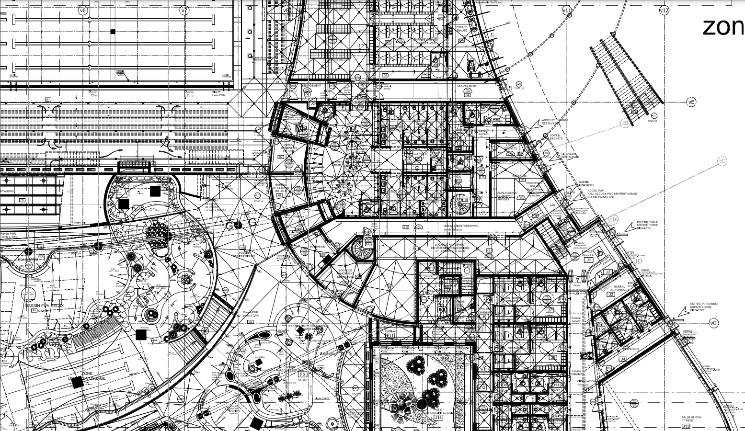
Victory ceremonies protocol
podium
Medals ceremonie call room

Slide 28
Start Sheets and Results

Slide 29
Call room information
Call rooms located next to the warm up pool
Call room reporting procedures :
Heats, report at least 4 heats before their race.
For finals, including reserves, must report fifteen (15) minutes prior to the published start time of their race
Athletes MUST have their accreditation.

Slide 30
Protests and Appeals
Procedures :
Team Leader wishing to query a DQ should speak with the referee of the race only.
If the Team Leader wishes to make a protest against the referees decision they can request a Protest Form from the Referee or collect one at SID.
Appeal against a Protest. From from the Referee or collect one at SID.
Protest fee Euro 150
Appeal fee Euro 200
Only card payments will be accepted.

Slide 31
AQUAPOLIS – ZONE 4
Lifeguard
Medical area
NPC area
NPC area FRANCE

Slide 32
Additional Information
live stream information :
The entire event can be followed live on “Fédération Française Handisport” Youtube channel and/or on website “handisport-studio.tv”
Competition website : World Series Natation – 2023 (wpsfrance.org)

Slide 33
Flags, Banners etc
Please remove all such items at the and of the day.
Items left over night, in the communal areas, will be removed.
This does not affect those teams who have flags and banners in their own booked space

Slide 34
Thank you for your attendance and all the best with the Competition.

